Slide 1
138th TMS & AIME Awards Presentation February 17, 2009 San Francisco, California

Slide 2
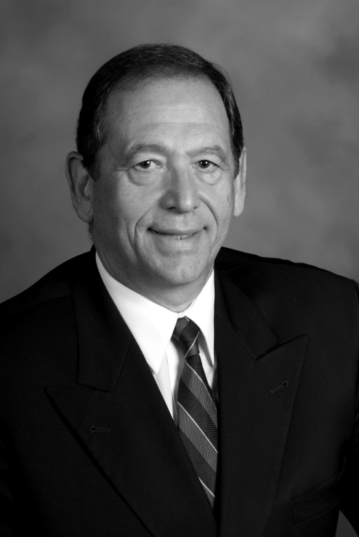
Conferring of AIME Honorary Membership Michael Karmis 2008 AIME President

Slide 3
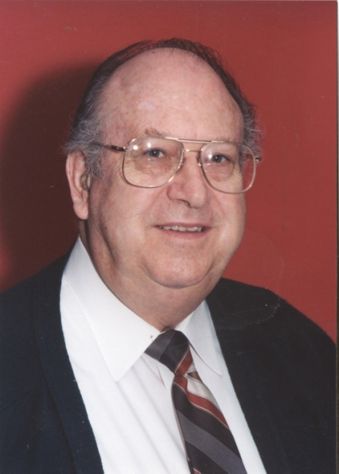
AIME Honorary Member
For his pioneering contributions to the field of hydrometallurgy, his service to professional societies, and his distinguished achievements in research and education.
Milton Wadsworth University of Utah

Slide 4
ACTA Materialia Materials and Society Award
For outstanding contributions concerning the interactions between materials and society.
Carolyn Hansson
University of Waterloo

Slide 5
ACTA Materialia Gold Medal Award
This international award recognizes an outstanding contributor to materials science.
Y. Austin Chang
University of Wisconsin

Slide 6
Conferring of TMS Honors and Awards Diran Apelian 2008 TMS President Ray Peterson 2009 TMS President

Slide 7
Graduate Outstanding Student Paper
First Place
Second Place
Hsiao-Yun Chen
National Chiao University
Nan Li
Texas A&M University

Slide 8
TMS J. Keith Brimacombe Presidential Scholarship
Whitney Patterson
Washington State University

Slide 9
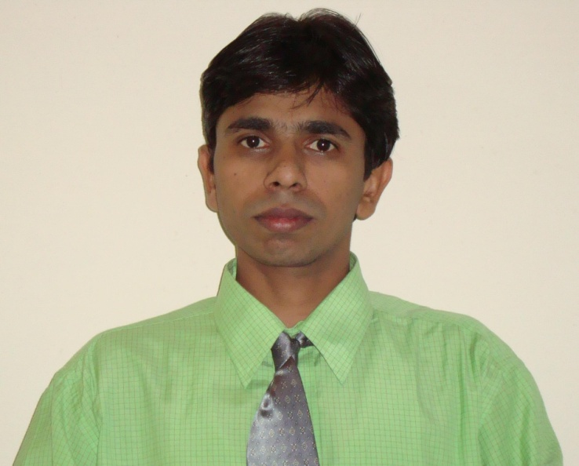
TMS Foundation Shri Ram Arora Award
This award recognizes, encourages and supports the quest for knowledge within the materials science and engineering community.
Sumatra Mandal
Indira Ghandi Centre for Atomic Research

Slide 10
International Scholar
Donald Siegel
Ford Motor Company

Slide 11
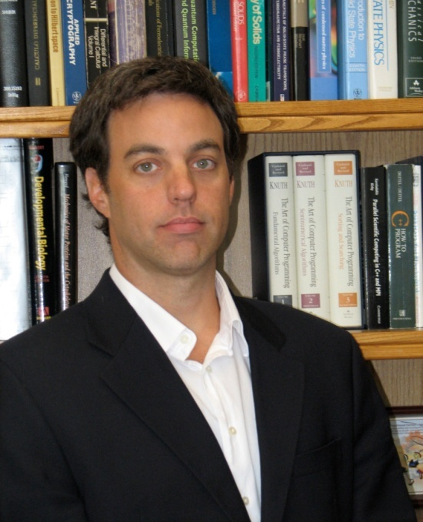
Early Career Faculty Fellow Award
This award honors an assistant professor for accomplishments that have advanced the academic institution where employed, and for abilities to broaden the technological profile of TMS.
Alejandro Strachan
Purdue University

Slide 12
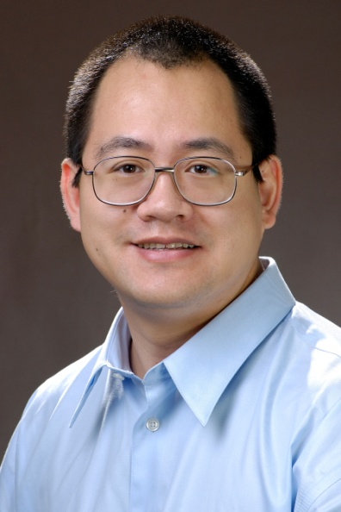
Robert Lansing Hardy Award
This award recognizes the exceptional promise of a young metallurgist for a successful career.
Ju Li
University of
Pennsylvania

Slide 13
Educator Award
For outstanding contributions to materials processing education through award-winning classroom teaching and industrial short courses, development of innovative undergraduate and graduate classes, and textbook writing.
Jonathan A. Dantzig
University of Illinois
at Urbana-Champaign

Slide 14
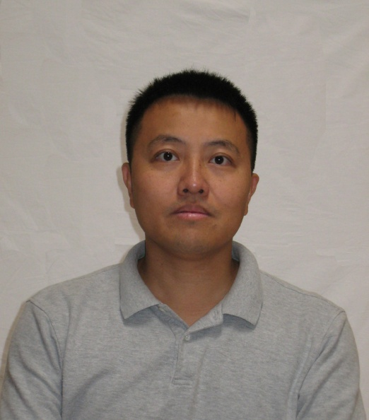
Champion H. Mathewson Award
This award is presented to an author of a paper considered the most notable contribution to metallurgical science.
Peng Li
Intel

Slide 15
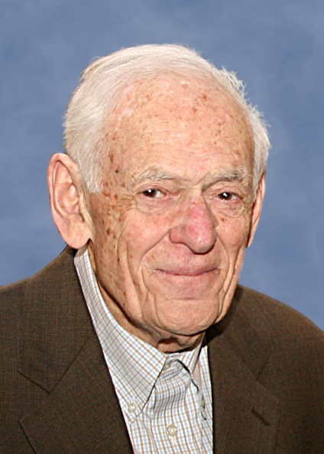
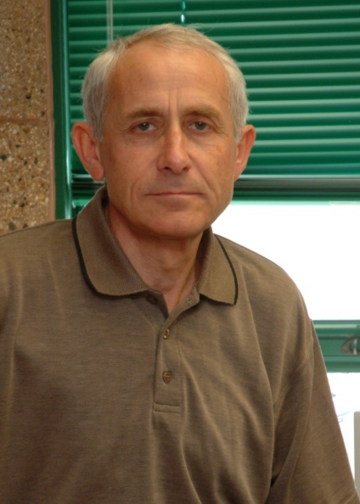
Application to Practice Award
For development of a steel with exceptional properties, research into the causes of these properties, and its use in the construction of a highway bridge.
Morris E. Fine
Northwestern
University
Semyon Vaynman
Northwestern
University

Slide 16
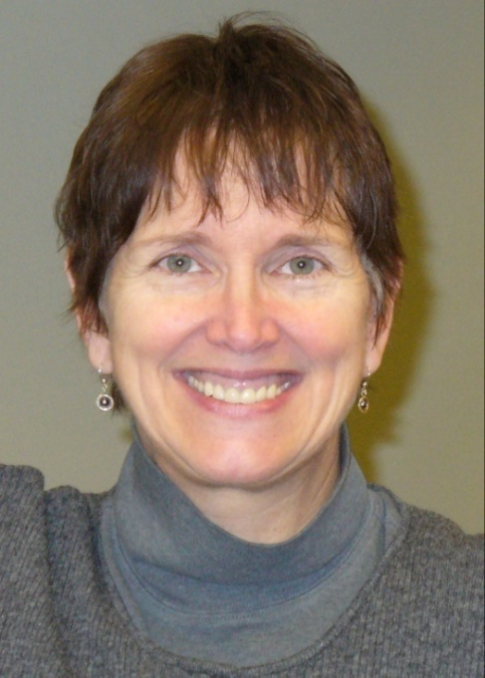
Leadership Award
For international leadership crossing government and industry lines in the development of lead-free solder alloys.
Carol A. Handwerker
Purdue University

Slide 17
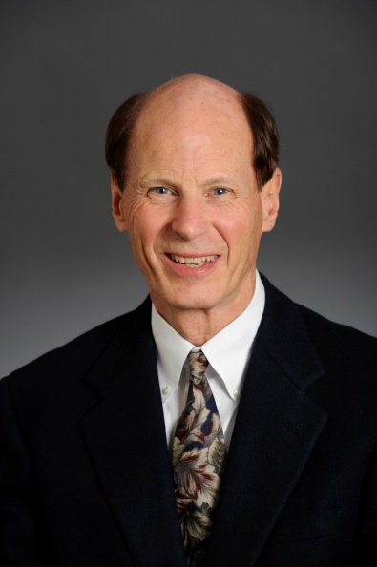
John Bardeen Award
For outstanding and creative contributions to science and technology of silicon carbide and group III nitrides.
Robert F. Davis
Carnegie Mellon
University

Slide 18
Bruce Chalmers Award
For his seminal contributions to microsegregation and back diffusion during dendritic solidification, in-situ composites and peritectic solidification, and computer modeling of solidification processing.
Harold D. Brody
University of
Connecticut

Slide 19
William Hume-Rothery Award
This award recognizes outstanding scholarly contributions to the science of alloys.
John H. Perepezko
University of
Wisconsin-Madison

Slide 20
Institute of Metals Lecturer and Robert Franklin Mehl Award
This award recognizes an outstanding scientific leader.
Herbert Gleiter
Institute of Nanotechnology,
Research Center Karlsruhe

Slide 21
Fellow—Class of 2009
For his major contributions to the field of mechanical behavior of materials and his mentoring of students for over 35 years.
William W. Gerberich
University of Minnesota

Slide 22
Fellow—Class of 2009
For outstanding contributions to the advancement of solidification science and application to alloying, grain refining, and casting of commercial aluminum, copper, and steel alloys.
Douglas A. Granger
Retired, Gras Inc.

Slide 23
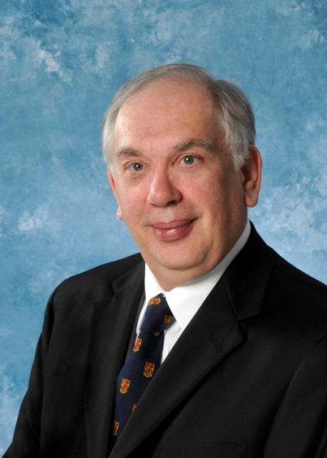
Fellow—Class of 2009
For outstanding scientific contributions in the field of atom probe field ion microscopy and the application of this technique to pioneering research in metallurgy.
Michael Miller
Oak Ridge
National Laboratory

Slide 24
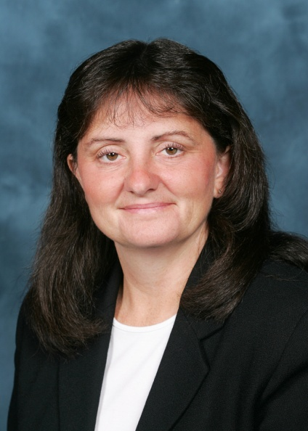
Fellow—Class of 2009
For seminal contributions in the understanding of high-temperature alloys, and for distinguished leadership in materials education and the materials profession.
Tresa M. Pollock
University of Michigan

Slide 25
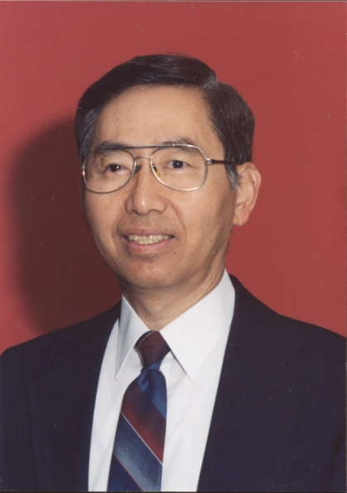
Fellow—Class of 2009
For his many outstanding contributions to the extractive and process metallurgy community in research and education, and for his exceptional service to TMS.
Hong Yong Sohn
University of Utah

Slide 26
2009 TMS President
Ray Peterson

Slide 27
Thank You!
We hope to see you next year in
Seattle, Washington!
139th TMS Annual Meeting & Exhibition
February 14-18, 2010

