Slide 1

TMS 101: Participating
Above the Presenter Level
Jeffrey W. Fergus, Auburn University
Clarissa Yablinsky, Los Alamos National Laboratory
Juan Pablo Escobedo-Diaz, University of New South Wales Canberra

Slide 2
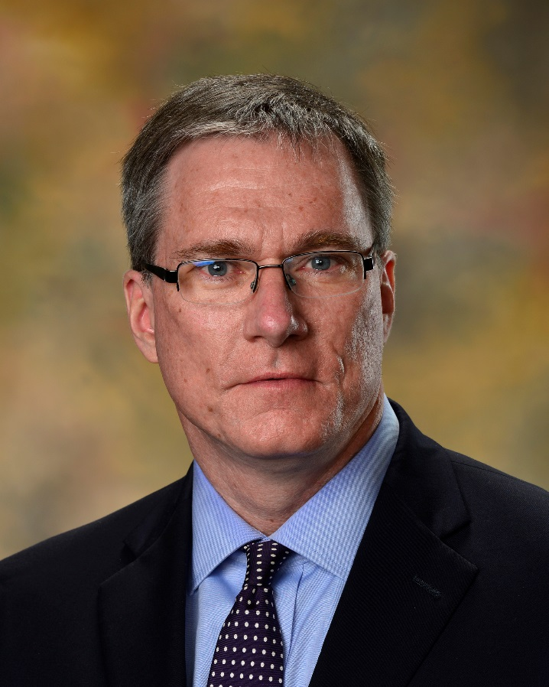
Jeffrey Fergus
Auburn University
Auburn, Alabama
-B.S. in Metallurgical Engineering, University of Illinois
-PhD in Materials Science and Engineering, University of Pennsylvania.
-Postdoctoral appointment, University of Notre Dame
-Professor of materials engineering and Associate Dean for Program Assessment and Graduate Studies, Auburn University (current)
At TMS he has organized symposia and chaired the accreditation and professional registration committees. He currently serves on the TMS Board of Directors as the Professional Development Director.
Notes:
There is a lot more that I could tell you about TMS, but for now, I would like to turn the program over to Clarissa Yablinsky, who will give you some first hand advice on how to get involved and what that can mean to your career.

Slide 3
Welcome First-Time TMS Annual Meeting Attendees
Remember to Pick Up Your
Orientation Packet and Gift
TMS Member Welcome Center
San Diego Convention Center
Ballroom 6 Lobby
Notes:
I’d like to extend a special welcome to those of you who are attending the TMS annual meeting for the very first time. TMS has a special orientation packet and a small gift waiting for you at the TMS Member Welcome Center at the Convention Center. Staff also has a few packets on hand in the back of this room if you would to take one with you as you leave.

Slide 4
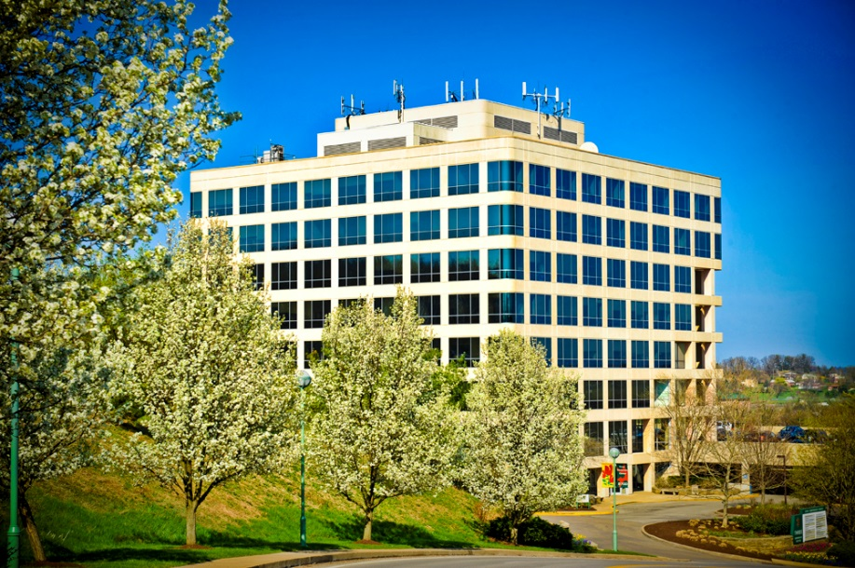
TMS in Brief
Individual membership organization—nonprofit, charitable association
Members decide society strategies, policies, and content. TMS member volunteers lead, organize, and implement society activities.
Board of Directors (14 members) represent membership constituencies and provide big-picture leadership
Headquarters in Pittsburgh, Pennsylvania, USA
Supported by 37 staff
Established in 1871 as part of the American Institute of Mining Engineers (AIME)
Separately incorporated in 1957
Notes:
TMS is a unique professional society in that it encompasses the full range of disciplines in minerals, metals, and materials science and engineering—from extraction and processing, to developing and producing, to recycling and reclaiming the materials that society needs to advance. Another key characteristic of TMS is that we are a member-driven organization. All of the programs and opportunities that we will touch on today exist because of the involvement of our members. Our Board of Directors is structured to provide representation of our member constituencies to ensure that our policies and decisions are truly reflective of their needs and expectations.

Slide 5
Our Mission and Vision
The mission of TMS is to promote the global science and engineering professions concerned with minerals, metals, and materials.
The vision of TMS is to be the professional society of choice for the worldwide minerals, metals and materials community.
Notes:
Our mission and vision are presented here. Because we are the professional home for so many diverse interests and points of view, we have established ourselves as a leader in convening the community for knowledge sharing and action on topics that require a collaborative and multi-disciplinary approach.

Slide 6
Who We Are: Our Members
INDIVIDUALS
Professionals | 7,659
Students | 5,164
REGIONS
EMPLOYERS
Academia | 41%
Industry | 40%
Government | 14%
Retired | 4%
Unknown | 2%
Notes:
This provides a quick look at who are members are. We are more than 13,000 members strong. And, although TMS is headquartered in the U.S., nearly half of our members hail from outside that country. TMS members can be found in 91 nations on every inhabited continent. Also, there is a perception that TMS is largely an academic organization. As you can see here, 40 percent of our membership work in industry.

Slide 7





Where We Are Heading: TMS Strategic Goals
Advance diversity and inclusion in the minerals, metals, and materials professions
Accelerate industrial engagement in TMS
Expand international activities
Advance materials solutions for energy and environmental challenges
Be the natural home and advocate for materials and manufacturing innovation
Notes:
The guideposts for how TMS serves its members and profession are five strategic goals adopted by our Board of Directors. These goals speak to TMS’ essential values, prioritize our actions, and shape our decision-making, development, and growth.

Slide 8
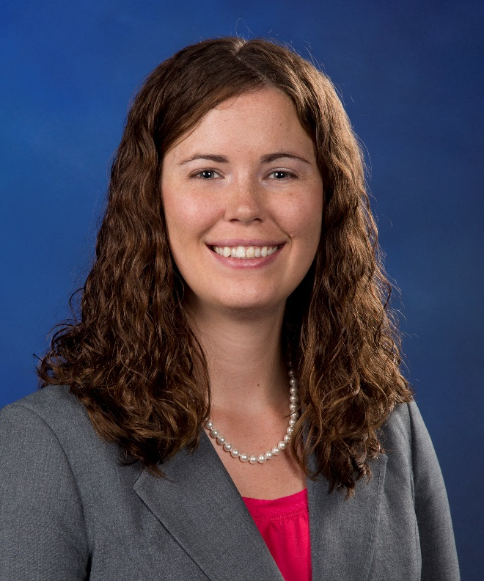
Clarissa A. Yablinsky
Los Alamos National Laboratory
Los Alamos, New Mexico
-BS in Materials Science and Engineering, Carnegie Mellon University
-M.S. and Ph.D. in Materials Science and Engineering, The Ohio State University.
-Research Associate at the University of Wisconsin in the EFRC Center for Materials Science of Nuclear Fuels
-Postdoctoral appointment at Los Alamos National Laboratory
-Scientist at Los Alamos National Laboratory (current)
At TMS she has volunteered on committees including the Mechanical Behavior and Nuclear Material Technical Committees; and the Membership, Professional Development, Young Leaders, Material Advantage, and Diversity Administrative Committees. She has also peer reviewed articles for JOM and Metallurgical and Materials Transactions A.
Notes:
There is a lot more that I could tell you about TMS, but for now, I would like to turn the program over to Clarissa Yablinsky, who will give you some first hand advice on how to get involved and what that can mean to your career.

Slide 9
How You Can
Become Involved
Expand Your Network.
Enrich Your Expertise.
Make a Difference.
Notes:
As mentioned before, TMS prides itself on being a member-driven organization. This means every member, regardless of where they are at in their career, where they live and what their time limitations are, have the opportunity to make a meaningful impact on their profession as a TMS volunteer. I just want to give you a quick overview of how you can get started on your own enriching journey as a TMS member.

Slide 10
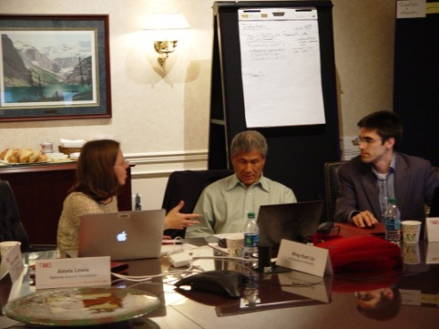
Join a Technical Committee:
Your Starting Point for Involvement
5 Technical Divisions:
Extraction & Processing Division (EPD)
Functional Materials Division (FMD)
Light Metals Division (LMD)
Materials Processing & Manufacturing Division (MPMD)
Structural Materials Division (SMD)
30+ technical committees:
Focused on specialty areas and topics
Some housed exclusively within a technical division; others cross divisions.
Notes:
This slide gives you a sense of how TMS accomplishes what we do through a robust structure supporting volunteer engagement. The starting point for many TMS members is to join a technical committee that aligns with your particular interest. With 30 technical committees, there are a lot to choose from. These committees are generally based in one of TMS technical division, which represents a broad interest community within the society. A few, however, cross over several divisions because of their multidisciplinary nature.

Slide 11
Join a Technical Committee:
Your Starting Point for Involvement
Additive Manufacturing (J)*
Advanced Characterization, Testing, & Simulation
Alloy Phases (J)*
Aluminum
Biomaterials (J)*
Chemistry & Physics of Materials (J)*
Composite Materials
Computational Mater. Sci. & Eng.
Corrosion & Environmental Effects
Electronic Packaging & Interconnection Mater.
Energy (J)*
Energy Conversion & Storage
High Temperature Alloys
Hydrometallurgy & Electrochemistry
ICME
Magnesium
Magnetic Materials
Materials Characterization
Mechanical Behavior of Materials
Nanomaterials
Nanomechanical Materials Behavior
Nuclear Materials
Phase Transformations
Powder materials
Process Technology & Modelling (J)*
Pyrometallurgy
Recycling & Environmental Tech. (J)*
Refractory Metals & Materials
Shaping & Forming
Solidification
Steels
Surface Engineering
Thin Films & Interfaces
Titanium
*(J) Joint Technical Committee
Notes:
Here is a listing of all of the technical committees available to you. All of the technical committees are open to TMS member participation. To find out if a technical committee is a good fit for your interests, I encourage you to sit in on one of the many committee meetings scheduled during TMS2016. You don’t need a special invitation to listen and begin your participation. There are a few division/committee representatives in the room now that I would like to recognize. . . Please feel free to ask them any questions you might have about becoming involved with their committees.

Slide 12
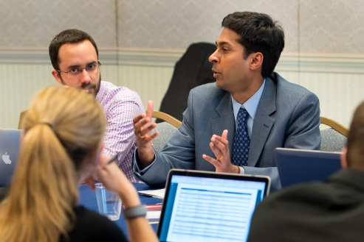
Technical Committee Opportunities
What You Can Do:
Propose and/or organize symposia
Serve as a session chair
Propose and/or organize a professional
development course or workshop
Organize and/or contribute to JOM
technical topics
Serve in a leadership position on the committee
Technical committees shape all TMS activity in a particular technical area.
What You Will Gain:
Expanded network of colleagues in your interest area
Knowledge of the latest advances in your field
Access to new volunteer opportunities
Enhanced profile as a leader and contributor to the profession
Notes:
You can become involved as much or as little as you want in a technical committee. A few of these opportunities are listed here. What you will gain, in terms of experience and exposure, is immeasurable. This is probably the most valuable avenue that you have available for connecting with your colleagues within your specialty area.

Slide 13
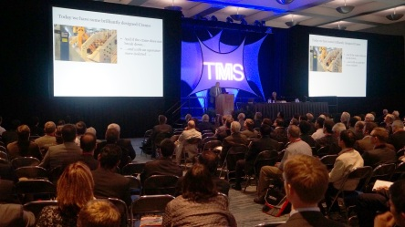
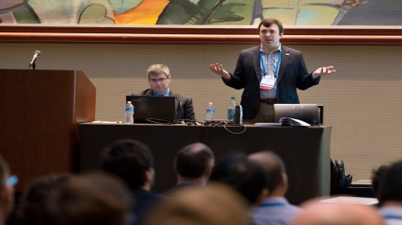
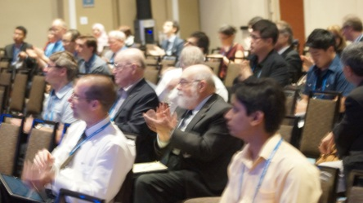
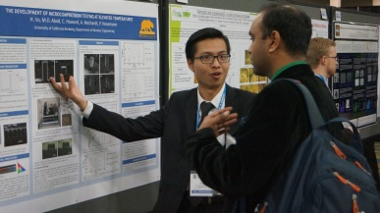
How to Organize Symposia
Take your idea to the committee meeting!
Basic symposia information: Title, organizers, and a brief description
Other considerations:
  Number of planned sessions
  Number of people expected per session
Co-sponsorship when possible: Having more than one committee approval decreases overlapping programming
Contact the committee chair with questions
Notes:
Many committee members are active in organizing symposia. This is an extremely enriching activity, but does require some planning and a great deal of collaboration, as you see here. If you are new to the process, be prepared for teamwork and be open to being coached by more experienced TMS members. If you believe you have a good idea for a symposia topic, by all means propose it! TMS is always looking for high-quality symposia.

Slide 14
Join an Administrative Committee
Look for the Call for Volunteers to participate in invitation-only committees
Open Committees
Diversity
Education
Materials Innovation
Public & Government Affairs
Young Professionals
Committees with Membership Requirements
Accreditation (ABET PEV)
Professional Registration (PE)
Invitation-Only Committees
Audit
Content Development & Dissemination
Division Councils
Financial Planning
Materials & Society
Membership & Student Development
Nominating
Professional Development
Program
Notes:
Many of our members are also interested in addressing issues that have an impact on our professional life and the future of our field, as well as the future of TMS. TMS provides you with an outlet for that, as well, in the form of our Administrative Committees. This slide lists the committees list the ones that are available for everyone’s participation. Some are available by invitation only—watch for a Call for Volunteers for those and consider participating if the topic interests you. For those of you ages 45 and under, I very much recommend becoming involved with the TMS Young Professional Committee. This group offers you a unique forum to develop collaborations that can benefit you throughout your life, while giving you access to a number of career development opportunities and award programs that TMS has created expressly for early career professionals.

Slide 15

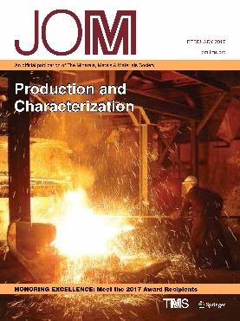
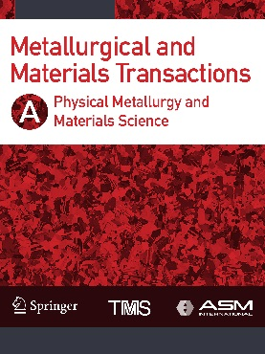
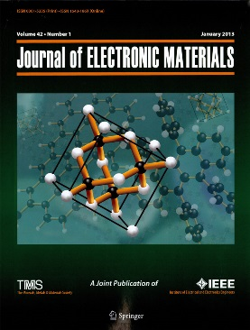
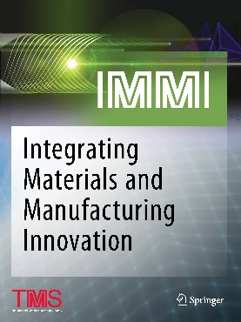
Edit/Review TMS Publications
Symposium papers are generally published in a TMS publication
JOM: The TMS member journal and flagship publication
  Topical issues
  Present your topic idea to a relevant committee
  Volunteer to review papers
Journals with a more focused editorial scope:
  Metallurgical and Materials Transactions A, B, E
  Journal of Electronic Materials
  Journal of Sustainable Metallurgy
  Integrating Materials and Manufacturing Innovation
Notes:
Another important way that you can become involved with TMS is by contributing as an author, topic organizer, peer reviewer or key reader for one of its journals.

Slide 16




Contribute to a Specialty Meeting
A great way to stay involved between TMS annual meetings
Sponsored by technical committees
  Narrowly focused
  Volunteer to help organize
  Suggest a workshop or course that aligns with the topic
  Contribute as a presenter
Participation in meetings on non-technical issues helps advance the profession
Notes:
Your active involvement with TMS does not have to begin and each Annual Meeting. A number of technical committees also sponsor specialty meetings and courses throughout the year, giving you another avenue for engagement. TMS also organizes non-technical meetings on occasion that focus on professional issues, giving you an opportunity to help advance the field as a professional community.

Slide 17
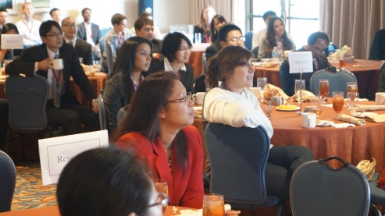
Get Started at TMS2017!
Scheduled Networking Opportunities
Open to All
  Sunday President’s Welcoming Reception
  Sunday Opening Plenary: Global Energy 2025
  Sunday Student Mixer
  Monday Young Professional Happy Hour Reception
  Monday Exhibit Opening Reception
  Tuesday Young Professional Tutorial Lecture
  Tuesday Student Career Forum
  Tuesday Exhibit Hall Happy Hour
  Wednesday TMS-AIME Awards Ceremony & Reception
  Poster sessions and receptions
  Division luncheons (Lecture portion open to all; Lunch requires pre-registration)
Notes:
This gives you an idea of how you can become more involved as a TMS members as soon as you leave this session and begin participating in the TMS annual meeting. Again, all of our technical committees are open to anyone who is interested. You do not need a special application or invitation. Just go to one that interests you, sit down, listen and ask questions. Be sure to get out an network, either informally during the technical program, or at one of the events listed here. If you don’t know how to begin, ask a colleague that you do know to introduce you to someone new. If you have specific questions about your TMS membership and how to get involved as a member, go to the TMS Member booth by the registration area. The TMS staff there will be happy to help.

Slide 18
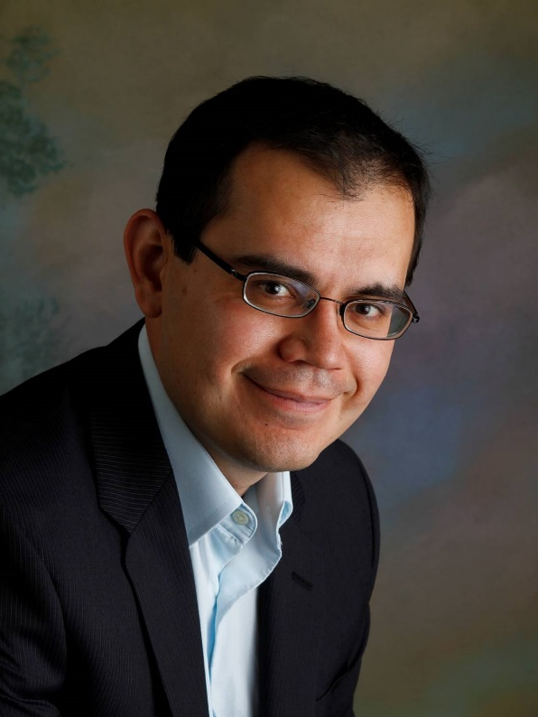
Juan Pablo Escobedo-Diaz
University of New South Wales
Canberra, Australia
-Ph.D. in Mechanical Engineering, Washington State University
-Held research positions at the Institute for Shock Physics, Los Alamos National Laboratory
-Senior Lecturer, School of Engineering and Information Technology, UNSW Canberra (current)
He has been a member of TMS since 2011 and has co-organized more than five annual meeting symposia, including the symposium on Characterization of Minerals, Metals and Materials since 2014. He was awarded a 2014 Structural Materials Division Young Leaders Professional Development Award.
Notes:
There is a lot more that I could tell you about TMS, but for now, I would like to turn the program over to Juan Pablo Escobedo-Diaz, who will give you some first hand advice on how to get involved and what that can mean to your career.

Slide 19
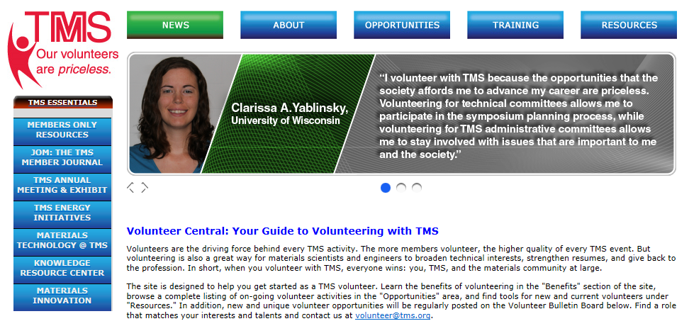
Stay Involved After TMS2017
Before You Leave This Session:
  Complete the sign up sheet
  Drop off your business card
  Or visit the TMS Volunteer Central web site any time
Notes:
In addition to participating in a committee meeting at TMS2016, you can also register your interest in a committee by logging on to the TMS website and navigating to the Get Involved tab in the Members Only section. For your convenience, we also have a sign up sheet for volunteer engagement and a business card drop in the back of the room.

