Slide 2
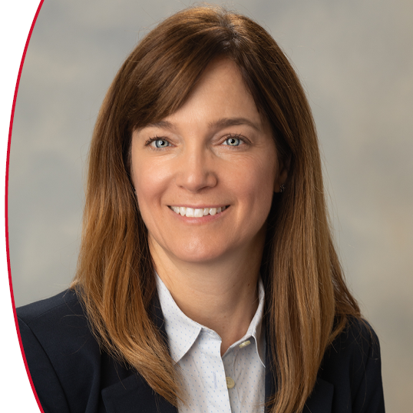
Presented by
Ellen Cerreta
Los Alamos National Laboratory

Slide 3
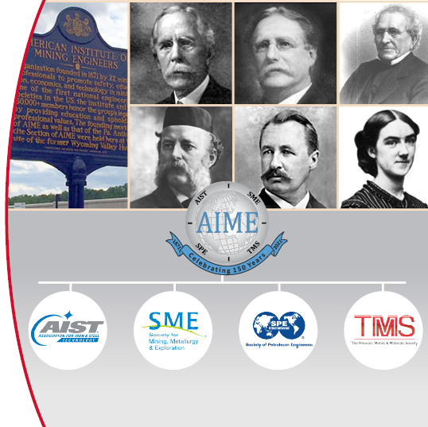
History of TMS
1871: Founding of TMS’s parent society, the American Institute of Mining, Metallurgical, and Petroleum Engineers (AIME)
1984: AIME establishes four member societies, now known as:
The Minerals, Metals & Materials Society (TMS)
Association for Iron & Steel Technology (AIST)
The Society for Mining, Metallurgy & Exploration (SME)
Society of Petroleum Engineers (SPE)

Slide 4
Our Mission and Vision
The mission of TMS is to promote the global science and engineering professions concerned with minerals, metals and materials
The vision of TMS is to be the professional society of choice for the worldwide minerals, metals and materials community

Slide 5
Diversity, Equity & Inclusion at TMS
DEI is a top priority embedded in the DNA of TMS; it permeates everything that we do.
TMS Diversity Statement
TMS is committed to advancing diversity in the minerals, metals, and materials professions, and to promoting an inclusive professional culture that welcomes and engages all who seek to contribute to the field. TMS recognizes that a diverse minerals, metals, and materials workforce is critical to ensuring that all viewpoints, perspectives, and talents are brought to bear in addressing complex science and engineering challenges. To build and nurture this diverse professional community, TMS welcomes and actively engages the participation of underrepresented groups in all of its initiatives and endeavors.

Slide 6
Diversity, Equity & Inclusion at TMS
Find resources you can use at www.tms.org/Diversity, including:
Diversity, Equity and Inclusion Toolkit
Meetings, Workshops, and Webinars
DEI Committee Activity
TMS Diversity Awards

Slide 7
Membership Affiliations

Slide 8
TMS Benefits and Opportunities for Impactful Engagement and Networking
Conferences and Meetings [See Module 2]
Committee Engagement
Technical Committees [See Module 3]
Functional Committees [See Module 4]
Publications [See Module 6]
Short Courses (online and in-person)
Awards
International Engagement
TMS Foundation

Slide 9
TMS Events Portfolio Includes…
See Module 2 for Detail About TMS Events

Slide 10
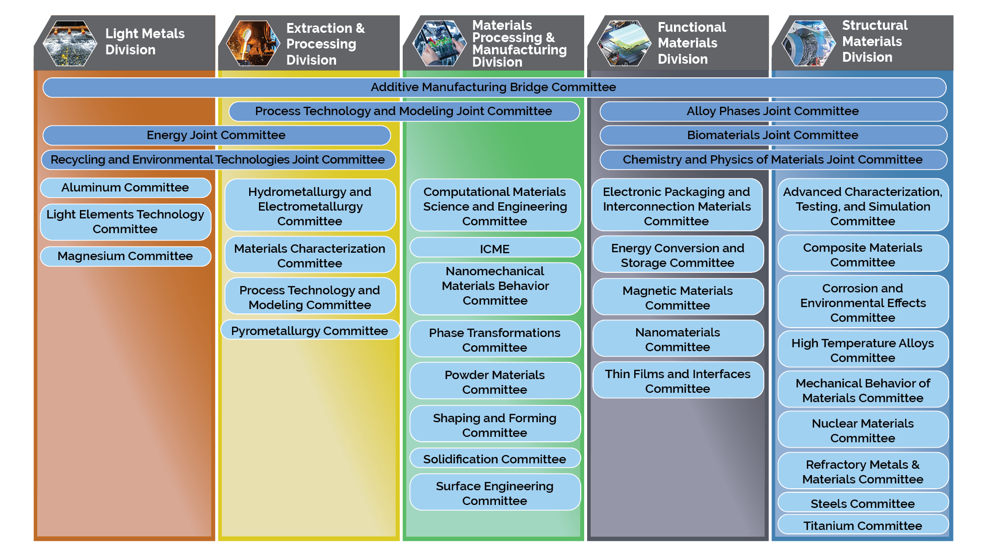
TMS Technical Divisions & Committees
One of the most foundational, critical steps to get engaged in TMS activities is to
join a TMS Technical Committee
Choose one of the ~ 35 committees that best suits you and fill out a technical committee interest form at www.tms.org/ Committees
See Module 3 for Details

Slide 11
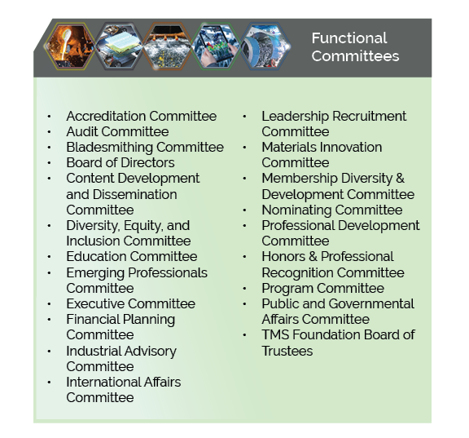
TMS Functional Committees
TMS functional committees and technical division councils help oversee the high-level activities of the Society, organize technical and non-technical initiatives, and provide guidance on special topics
Participation in most functional committees is by invitation only, following a nomination process
Learn more at www.tms.org/FunctionalCommittees
See Module 4 for Details About Functional Committees

Slide 12
TMS Volunteer Organization Structure

Slide 13
TMS Publications
TMS publishes six journals, proceedings volumes from events like the TMS Annual Meeting & Exhibition, and textbooks.
Learn more about journals at www.tms.org/Journals
Learn more about proceedings and textbooks at www.tms.org/Bookstore
See Module 6 for Details

Slide 14
TMS Studies
TMS develops science and technology accelerator/roadmapping studies that set a strategic future for the materials community.
Learn more at www.tms.org/Studies
See Module 6 for Details

Slide 15
Professional Development Courses
Impactful Virtual and In-Person Courses
See full array of TMS courses (past and upcoming) at: www.tms.org/PD

Slide 16
Honors and Awards
The recognition of outstanding accomplishments by members of the international minerals, metals, and materials community is an important objective of TMS
These awards take the form of:
Society-Level Awards
Division-Level Awards
Young Professional Awards
Student Scholarships and Awards
Other Awards – AIME, Acta Materialia, etc.

Slide 17
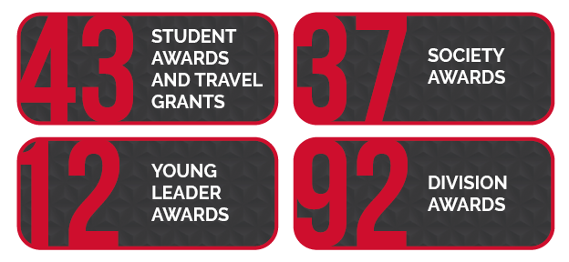
Honors and Awards
In 2023, TMS awarded:
Learn more at: www.tms.org/Awards

Slide 18
International Engagement

Slide 19
TMS Foundation
The TMS Foundation supports students and young professionals with meaningful financial assistance and impactful career-building experience
The TMS Foundation supports the following philanthropic causes:
Student Scholarships, Competitions, and Awards
Young Professional Programs
Diversity Awards
Career Capstone Awards
K-12 Outreach

Slide 20
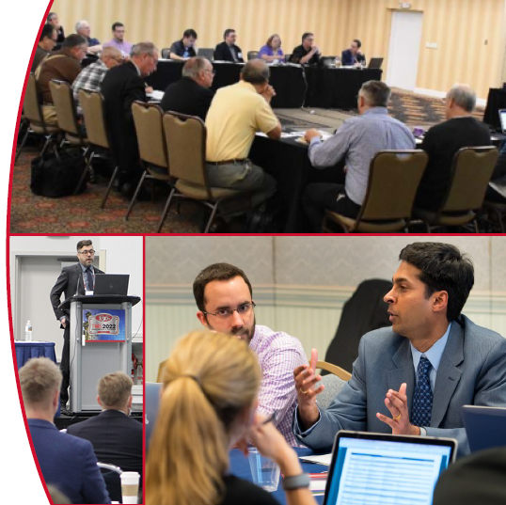
How Can You Become Involved?
Join a Technical Committee! Then…
Propose and/or organize symposia (and/or short courses)
Serve as a session chair
Organize and/or contribute to JOM technical topics
Serve in a leadership position on the committee
See module 3 for details
Visit www.tms.org/volunteer to begin!

Slide 21
How Can You Become Involved?
Become a member of a Functional Committee
See module 4 for details
Edit/Review TMS Publications
See module 6 for details
Contribute to a Specialty Congress/Conference
See module 2 for details
You can get started at the next TMS Annual Meeting & Exhibition!
Visit www.tms.org/volunteer

