Slide 2
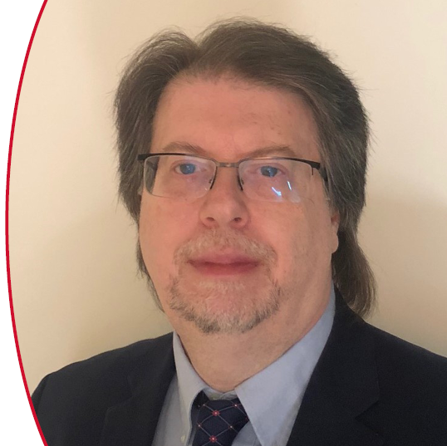
Presented by
Paul Mason
Thermo-Calc Software Inc.

Slide 3
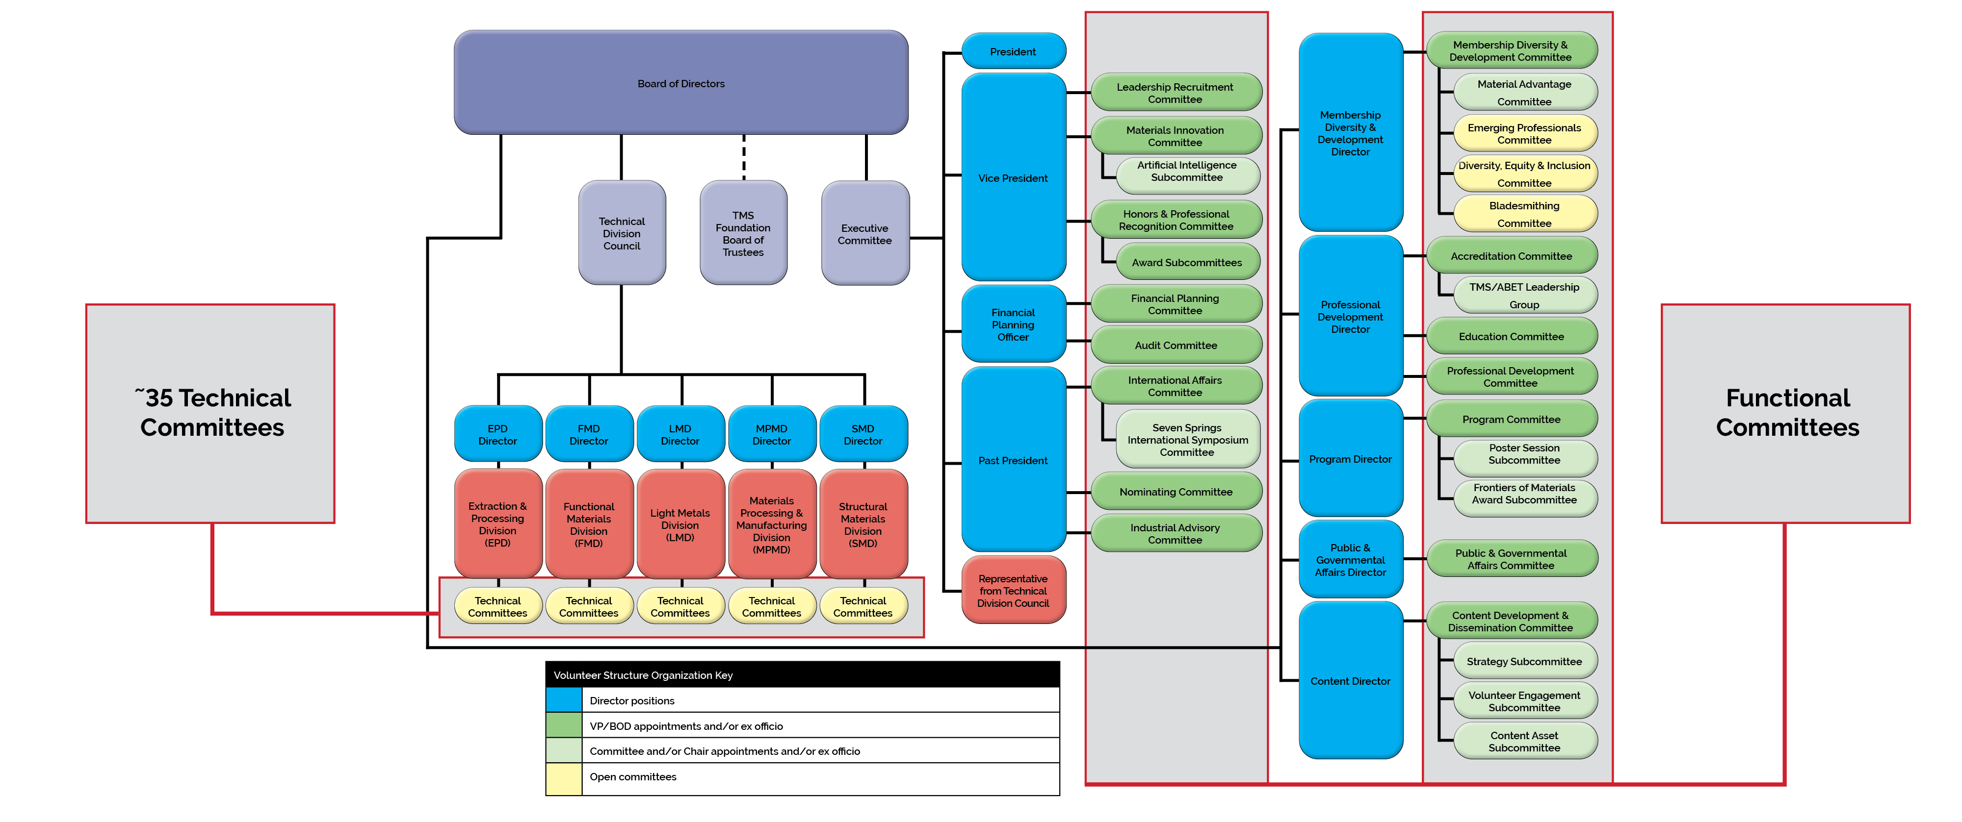
TMS Volunteer Organization Structure

Slide 4
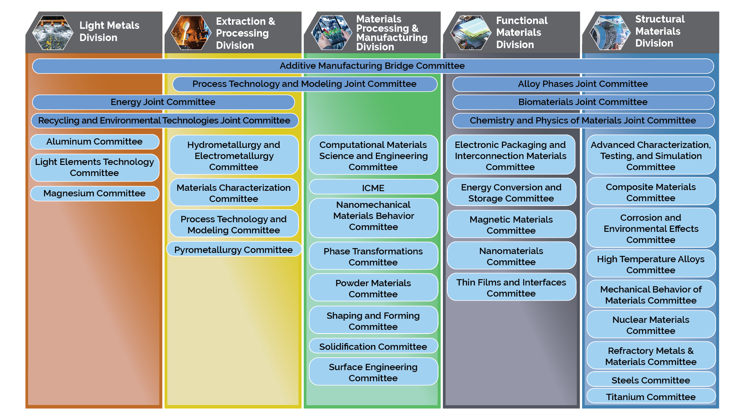
TMS Technical Committees
Probably the best way to get engaged in TMS activities is to join a technical committee(s)
If not yet on one, choose which of the ~35 committees best suits you, and join
For more information visit https://www.tms.org/portal/DIVISIONS___COMMITTEES

Slide 5
Benefits of Joining a Technical Committee
Expand Your Network, Enrich Your Expertise, Make a Difference
Expand your network of contacts (and friends)
Make and retain long-lasting, beneficial, professional relationships by working with committee members and attending meetings (for years or even decades)
Develop research collaborations
Learn and grow in your area of expertise
Make a strong impact on the field of materials science and engineering and help determine future directions of this field

Slide 6
What Do Technical Committees Do?
Programming
“Programming” refers to symposia at TMS events, most commonly the TMS Annual Meeting & Exhibition, and these symposia consist of different sessions where speakers provide talks
Programming at TMS begins with the volunteer members, at the technical committee level
One or more technical committees must sponsor a symposium; however, no symposium is valid (and abstracts can’t be accepted) until it is approved by the TMS Program Committee (a Functional Committee)

Slide 7
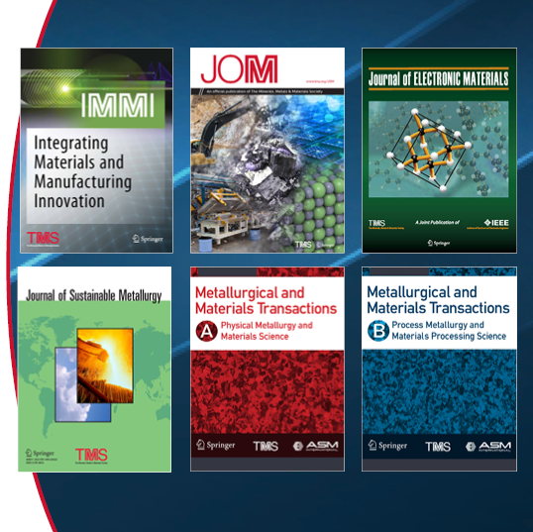
What Do Technical Committees Do?
Publications
A JOM Advisor is appointed by each Technical Committee
These committee members propose committee topics for the journal
They shepherd the solicitation and review of submissions for each topic
TMS staff provides a resource toolkit for JOM Advisors
Committees can also contribute content to other TMS journals
Committees/divisions can also consider Annual Meeting symposia for proceedings publications

Slide 8
What Do Technical Committees Do?
Honors & Awards
Each TMS Technical Division presents awards at the TMS Annual Meeting
Some Technical Committees also administer awards
Committees are encouraged to discuss awards and nominate qualified candidates
Please note, however, that TMS members can in general nominate colleagues for any TMS awards
A summary of TMS awards and how to nominate for these awards are provided on the TMS website at: www.tms.org/Awards

Slide 9
Join a Technical Committee
Your Starting Point for TMS Involvement
Look online at the ~35 technical committees and find the one that best suits you
Fill out a technical committee interest form at www.tms.org/Committees
You can also attend any technical committee meeting as a visitor—to see what they do and how they operate
Then join the committee
Many members eventually serve on multiple committees

Slide 10
Ways to Volunteer On A Committee
At the meetings, seek to volunteer in some capacity:
Help organize a symposium for the TMS Annual Meeting & Exhibition, or the TMS Fall Meeting (held at MS&T)
Contribute to a Specialty Conference/Congress
Organize and/or contribute to technical topics in the TMS member journal JOM, or volunteer to review papers submitted to JOM
Help coordinate or develop new educational content/courses
Identify mentors with whom to partner, or become a mentor to someone else
Serve in a leadership position on the committee (secretary, vice chair, chair)
Perhaps ascend to Technical Division leadership
Commit to something that excites you!

Slide 11
Get Started at the Next TMS Annual Meeting & Exhibition!

Slide 12
Stay Involved
Visit www.tms.org/volunteer

