Slide 2
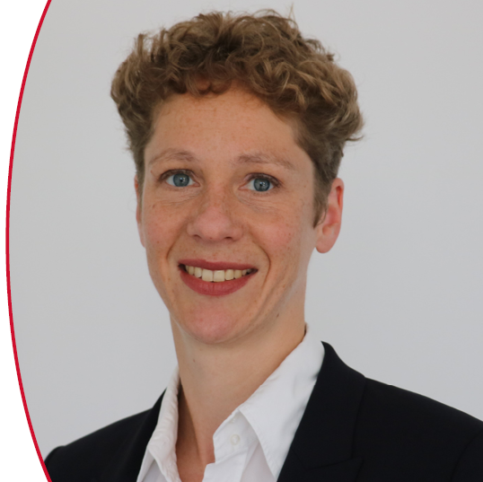
Presented by
Christina Meskers
SINTEF

Slide 3
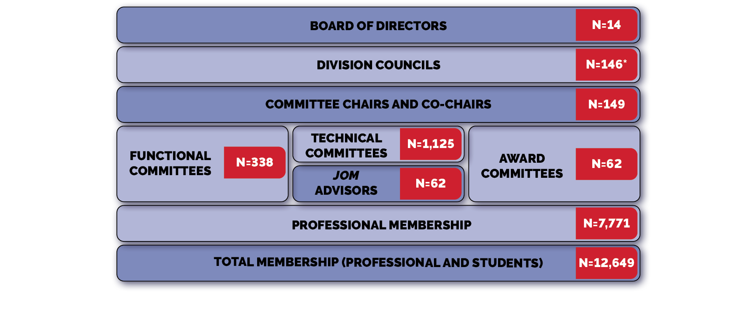
TMS Volunteer Ladder
N = number
of members
*Includes Technical Committee Chairs and Technical Division Functional Committee Representatives

Slide 4
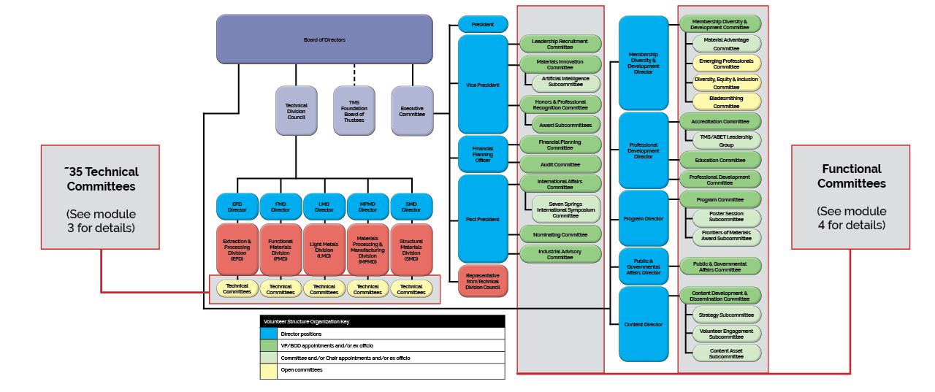
TMS Volunteer Organization Structure

Slide 5
Where Do You Start on
Your Pathway to Volunteer Leadership?
Join a Technical Committee! [LINK TO MODULE 3-will be added later]
Contribute to a Specialty Congress/Conference [LINK TO MODULE 2-will be added later]
Edit/Review TMS Publications [LINK TO MODULE 6-will be added later]
Become a member of a Functional Committee [LINK TO MODULE 4-will be added later]
You can get started at the next TMS Annual Meeting & Exhibition!
Visit www.tms.org/volunteer

Slide 6
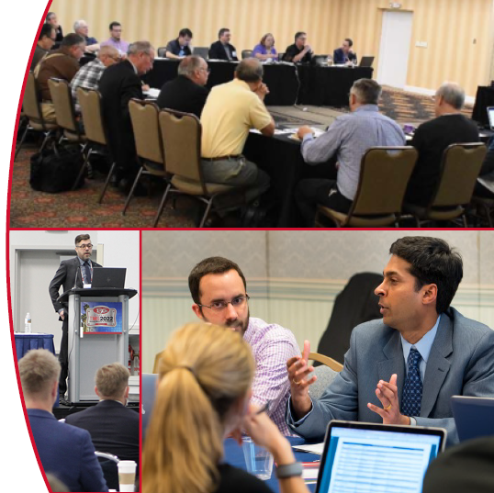
Join a Technical Committee:
Your Starting Point for Involvement
5 Technical Divisions:
Extraction & Processing Division (EPD)
Functional Materials Division (FMD)
Light Metals Division (LMD)
Materials Processing & Manufacturing Division (MPMD)
Structural Materials Division (SMD)
~35 Technical Committees:
Focused on specialty areas and topics
Some housed exclusively within a technical division; others cross divisions.
See www.tms.org/Committees

Slide 7
Technical Committee Opportunities
Technical committees shape TMS activities in a particular technical area
What You Will Gain:
Expanded network of colleagues in your interest area
Knowledge of the latest advances in your field
Access to new volunteer opportunities
Enhanced profile as a leader and contributor to the profession
How You Can Get Involved On a Committee:
Propose and/or organize symposia
Serve as a session chair
Propose and/or organize a professional development course or workshop
Organize and/or contribute to JOM technical topics

Slide 8
Technical Committee Opportunities
Then Ascend to a Leadership Position
Serve as a committee secretary, vice-chair, or chair
Then possibly ascend to a TMS technical division leadership position

Slide 9
Join a TMS Functional Committee
Open Committees
Bladesmithing
Diversity, Equity & Inclusion
Emerging Professionals
Committees with Membership Requirements
Accreditation (ABET PEV)
Invitation-Only Committees
Content Development & Dissemination
Education
Financial Planning
Honors & Professional Recognition
Industrial Advisory
Leadership Recruitment
Materials Innovation
Membership Diversity & Development
Nominating
Program
Public & Government Affairs
TMS Foundation Board of Trustees
See www.tms.org/Committees for more information

Slide 10
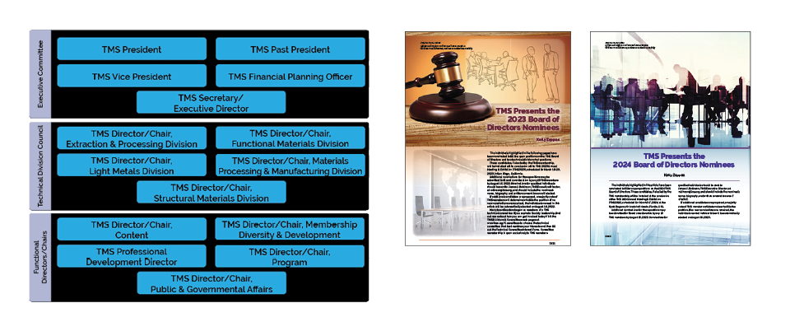
2023 TMS Board of Directors
All board nominees are presented in JOM: The Magazine for approval by the TMS membership.

Slide 11
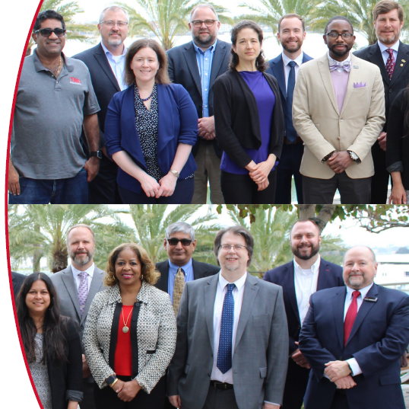
TMS Board of Directors Selection Process
Two key elements
  Governance requirements imposed by the TMS Bylaws
  Procedures developed by the BOD to satisfy Bylaws requirements
Bylaws Requirements
  BOD is to consist of 13-15 members each serving three-year term
  All Directors must be approved by the TMS membership via presentation of a slate of candidates assembled by the BOD
  If membership does nothing in response to the slate, nominees are automatically elected
  Alternatively, 25 members can advance a separate candidate for one of the open positions and require that an election be held

Slide 12
TMS BOD Implementation Procedures
(developed by BOD)
Outside of individuals in the Presidential Cycle, all BOD members must serve as chair of a technical division, or a board-level functional committee
  Presidential cycle: includes the Vice President, President, and Past President
  Board-Level Functional Committee Director/Chair positions: Financial Planning Officer, Professional Development Director, Content Director, Membership Diversity & Development Director, Program Director, Public and Governmental Affairs Director
The slate of candidates is developed in two ways…
  Each of five Technical Division Councils elects a candidate to Chair the division, and the BOD automatically adds that candidate to the slate
  Board appoints TMS Nominating Committee to review incoming nomination packages that are submitted for all other Board positions
    The Nominating Committee identifies best-suited candidates and gives a recommendation to BOD
    BOD considers recommendations, then decides whether to add nominees to the slate, or make changes

Slide 13
In Summary
There are two primary paths to serving on the TMS Board of Directors:
Ascend to a Technical Division Chair
Ascend to Chair of a BOD-level Functional Committee
Learn more at www.tms.org/Governance .

