Slide 2

Presented by
Tresa Pollock
University of California, Santa Barbara

Slide 3
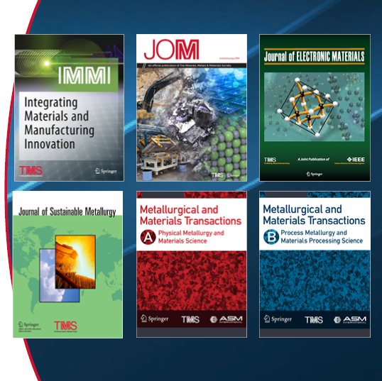
Journals
TMS owns or co-owns six journals:
  Integrating Materials and Manufacturing
  Innovation
  JOM
  Journal of Electronic Materials
  Journal of Sustainable Metallurgy
  Metallurgical and Materials Transactions A and B (co-owned with ASM International)
All journals are published in partnership with Springer Nature. See www.tms.org/Journals for more information and to access the journals for free with your membership.

Slide 4
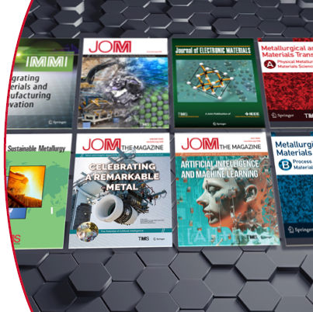
JOM: The Member Journal of TMS
Publication encompasses two sections:
  JOM: The Magazine shares news and information about TMS, its members, and its stakeholder communities.
  JOM: The Journal publishes peer-reviewed articles encompassing the breadth of materials science and engineering.
An interactive PDF of each Magazine issue is available for download at no cost to TMS members; additional online-only Magazine content is published four times per year.
All JOM content is accessible through www.tms.org/JOM.

Slide 5
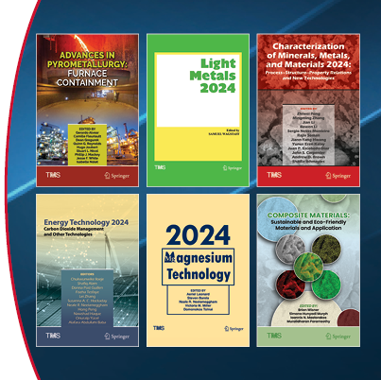
Books
Approximately 10 proceedings publications are produced each year from the TMS Annual Meeting & Exhibition.
Proceedings publications from select TMS specialty conferences are published. (The Superalloys proceedings publication is a longstanding example.)
Non-proceedings textbooks and monographs are published sporadically.
All books are published in partnership with Springer Nature. See www.tms.org/Bookstore for more information and to purchase books at a discount with your membership.

Slide 6
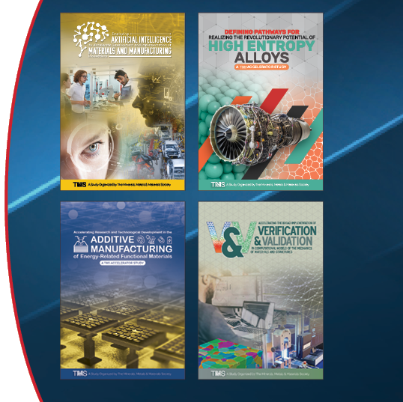
Studies and Reports
TMS convenes well respected technical experts from the minerals, metals, and materials communities to develop influential science & technology accelerator studies and reports.
These government-sponsored study reports are freely available to the public regardless of TMS membership status.
See www.tms.org/Studies for more information and to access the reports.

Slide 7
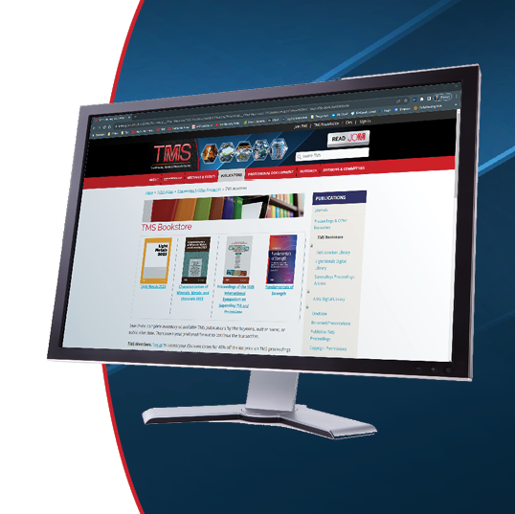
Maximize Your Member Benefits
Access Journal Content and Book Discounts
Journals: TMS members have free electronic access to the complete library of TMS published journals, including decades of archived articles, plus 20 additional materials-related journals offered by Springer. Log in at www.tms.org/Journals to select your journal(s).
Books: TMS members receive 40% off the list price of TMS proceedings publications, a 20% discount on TMS non-proceedings titles published by Springer, and a 20% discount on all other Springer products. Log in at www.tms.org/Bookstore to see applicable discount codes.

Slide 8
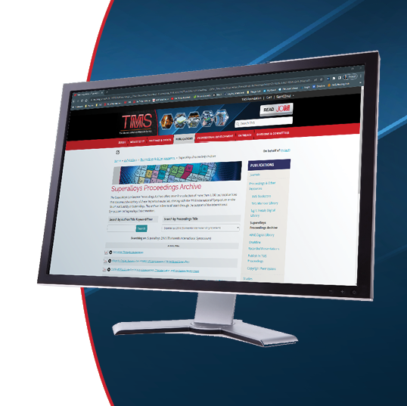
Maximize Your Member Benefits
Access TMS Online Libraries
Member Library: Members have free access to nearly 3,000 technical articles published by TMS, searchable by author, year, or title keyword.
AIME Digital Library: Members receive free access to more than 550 technical documents from the American Institute of Mining, Metallurgical, and Petroleum Engineers (AIME) archives.
Superalloys Proceedings Archive: A collection of more than 1,000 technical articles from Superalloys conference proceedings publications, free to all users.
Log in to members.tms.org to start reading.

Slide 9
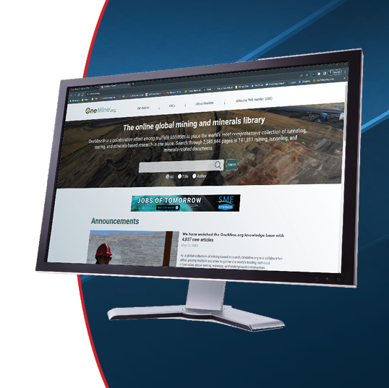
Maximize Your Member Benefits
Purchase Additional Library Subscriptions
Light Metals Digital Library: Members receive discounts on individual paper purchases and can purchase yearly subscriptions to this library of more than 6,300 technical papers, published from 1971 to 2015 as part of TMS’s Light Metals proceedings series.
OneMine: Members can subscribe to this resource for mining and minerals research published by multiple society partners.
Visit members.tms.org to learn how to add these benefits to your membership.

Slide 10
How to Get Involved in TMS Publications
Submit your work to a TMS journal or review manuscripts for a TMS journal. Contact the respective journal for more information. www.tms.org/Journals
If presenting at the TMS Annual Meeting & Exhibition, consider submitting a proceedings manuscript. All presenters have an opportunity to publish regardless if the symposium organizers have a plan to collect manuscripts.
Consider publication opportunities through a TMS technical committee. Committees appoint JOM Advisors who propose committee topics for the journal’s editorial calendar and are involved in the solicitation and review of manuscripts for each topic.

