Slide 1

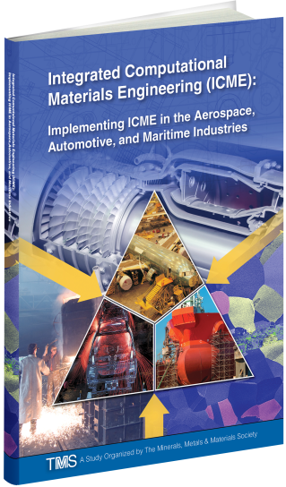
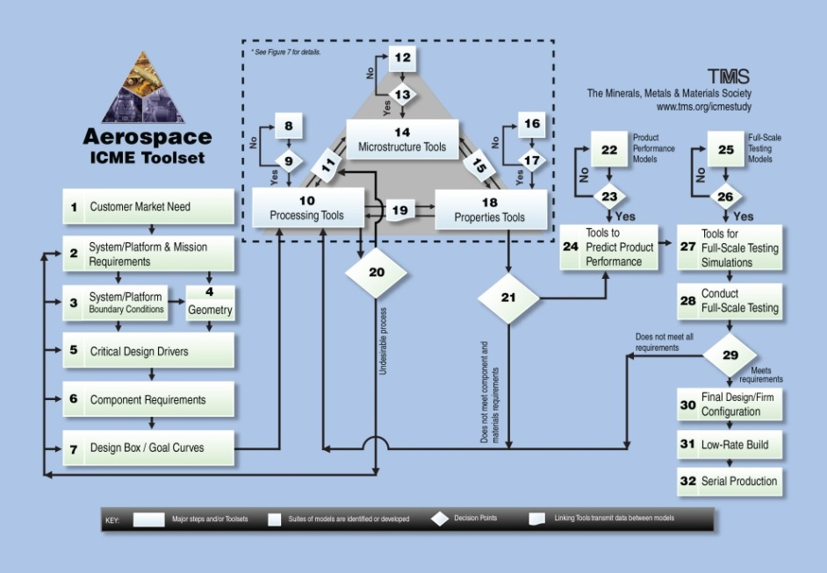
Integrated Computational Materials Engineering: Implementing ICME in the Aerospace, Automotive, and Maritime Industries
An Important New TMS-led ICME Implementation Study/Report
Sponsored by the U.S. Department of Defense (ONR, AFRL), the U.S. Department of Energy, and the U.S. National Science Foundation
Available for free download at: www.tms.org/ICMEStudy
Some Highlights of the Report:
Detailed ICME frameworks for accelerating product & manufacturing development
Fundamental building blocks & personnel required to employ ICME to accelerate product development programs
In-depth recommendations on how to make the ICME business case for various stakeholders in industry, academia, and government
Recommendations of more than 50 specific project/product opportunities for near term ICME implementation
Further resources: Table of ICME computational tools (and on-line access), additional reading….
A Sample Framework

